Slide 1
Excel Final Assessment

Slide 2
Q1
DATA CLEANING
Insights:
Removed duplicate elements
Removed all null values and replace it with the median.
Formulas used:
COUNTBLANK(A:P)
AVERAGE(l:l)

Slide 3
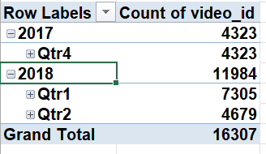
Q2
Time Analysis

Slide 4
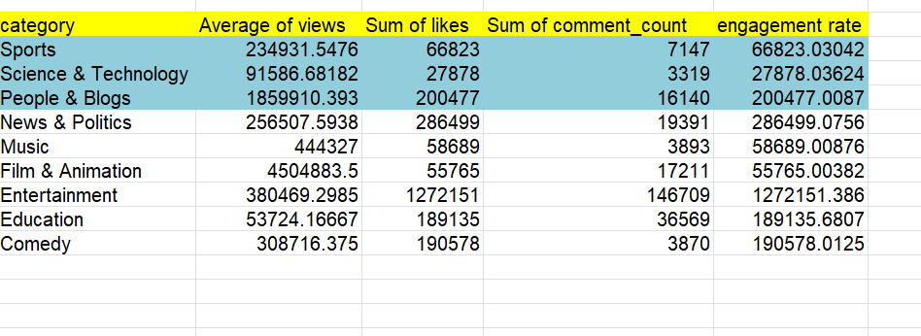
Q3
Insights:calculated the average and engagement rate
Formulas used:
(C4+D3)/E5

Slide 5
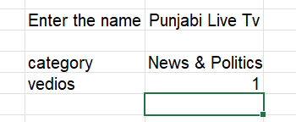
Q4
Filter and xlookup
Used xlookup to find category and id
Used filter and count for getting vedios
Formulas used:
XLOOKUP(XLOOKUP(U5,'YouTube data'!D:D,'YouTube data'!E:E),'YouTube data'!E:E,'YouTube data'!Q:Q)
COUNTA(FILTER('YouTube data'!A:A,'YouTube data'!Q:Q=Sheet8!U7))

Slide 6
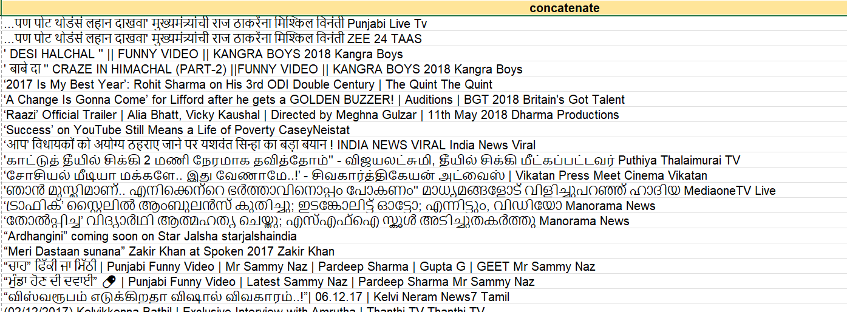
Q5
Insights:
Concadenate the columns
Formula used:
CONCATENATE(A2," ",B2)

Slide 7
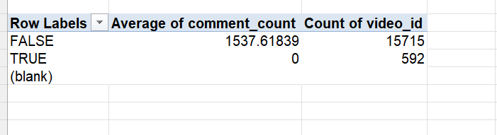
Q6
Insights:
Want to calculate average of comment_count against comments disables
Created pivot to analyse

Slide 8
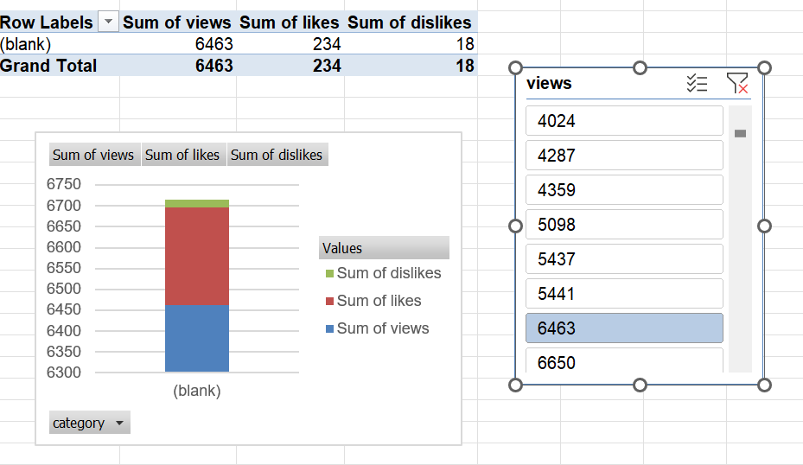
Q7
Example:
Taking category Vs likes ,views dislikes

Slide 9
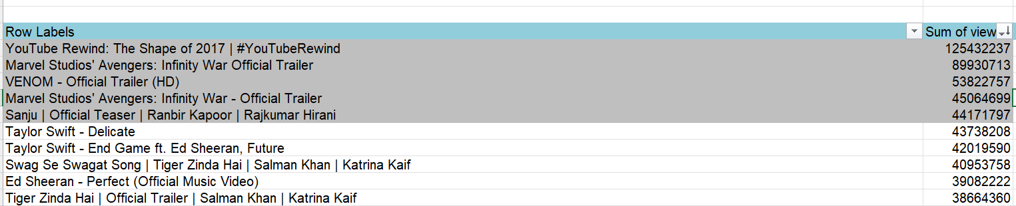
Q8
Insights:
Top 5 and bottom 5 vedios based on views-Pivot table

Slide 10
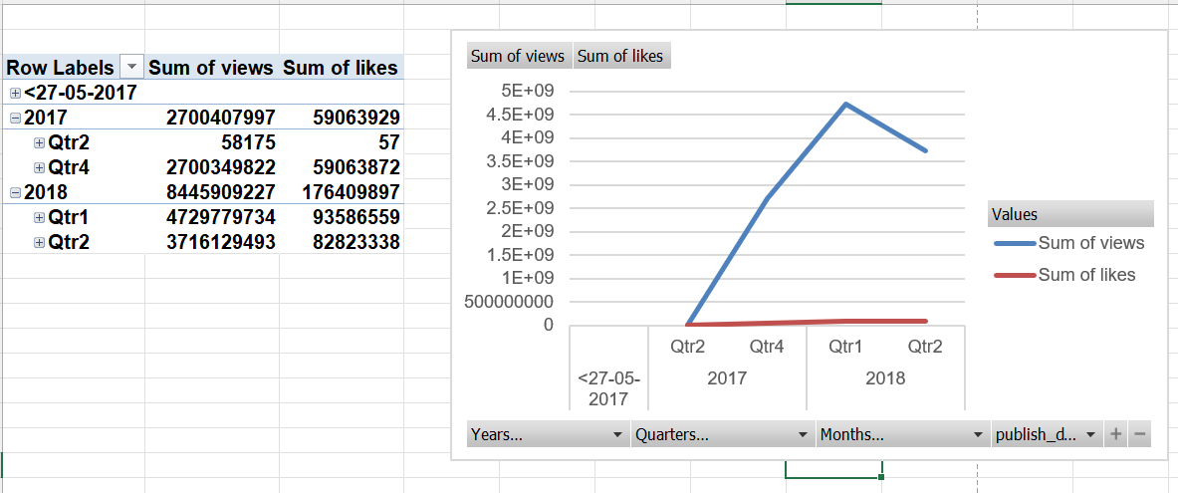
Q9
Filtering:

Slide 11
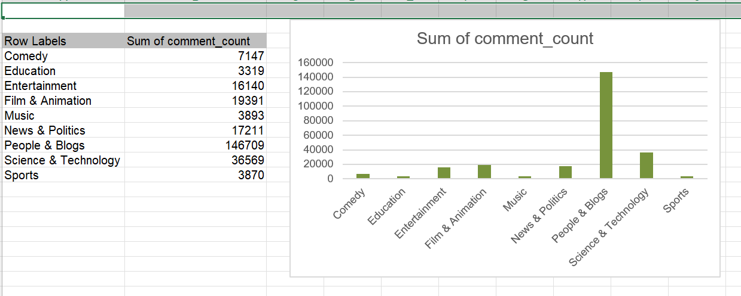
Q13
Analysed the comment count by category.

Slide 12
Q10

Slide 13
Q14
Grouped videos by category and compared between the metrices.

Slide 14
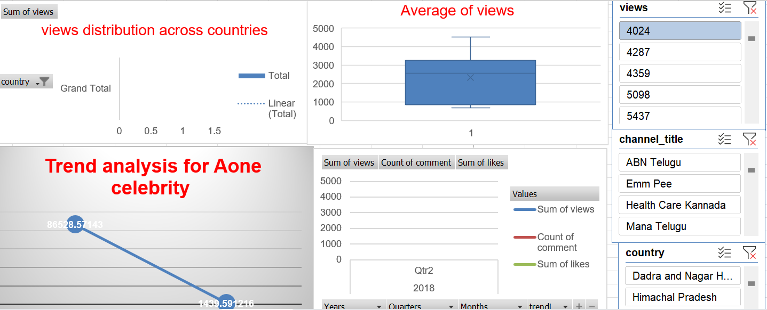
Q16-20-dashboard

